Slide 1
Data Visualization of Netflix Shows
By: Jake Creasy and Nate Hedrick
Year 2024

Slide 2
Goals
Our goal with the project was to take in data using Jupyter Notebook and create a bar chart race of Netflix shows.
Jake took the time to gather information about all Netflix shows he watched and put them into an excel csv file.

Slide 3
Coding Example
To get an understanding about how to create our bar chart race, we had found an example that took a look at the most populous provinces in Turkey from 2007 to 2018.
Having written this code, we had learned a lot more about Jupyter Notebook and how to code with panda.

Slide 4
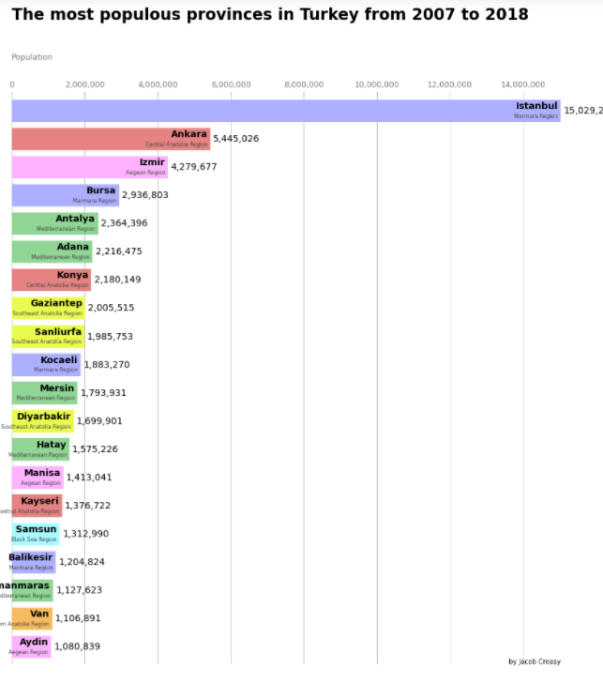
Turkey Bar Chart
This is the bar chart of the Turkey provinces.
It shows all the provinces within Turkey that have the highest population.

Slide 5
Netflix Bar Chart progress
After getting the help from the example bar chart, Jake and I finally started working on our Netflix bar chart.
Learning to code within Jupyter Notebook was a new experience for the both of us. Jake had it easier because he was watching videos about the coding language. I was mainly learning from him and what he learned from the videos.

Slide 6
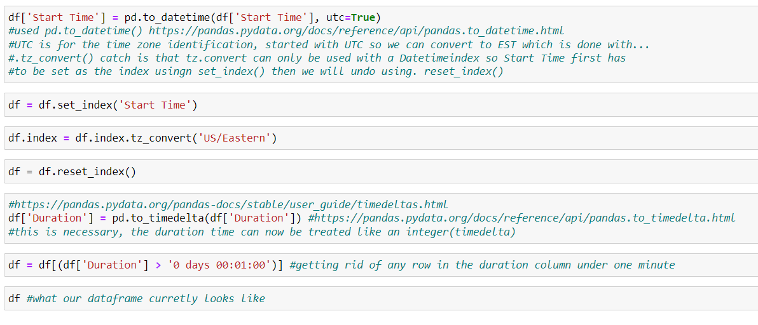
Netflix Bar Chart progress
We started off by opening Jake’s csv file within Jupyter Notebook. We used the .pop function to get rid of useless columns within the file we did not need. Then we took the column with “Start Times” and turned them into date and time, changed them to UTC then EST. And then we got rid of all of the rows with less than a minute of run time.
This is the code from above. Not including the .pop

Slide 7
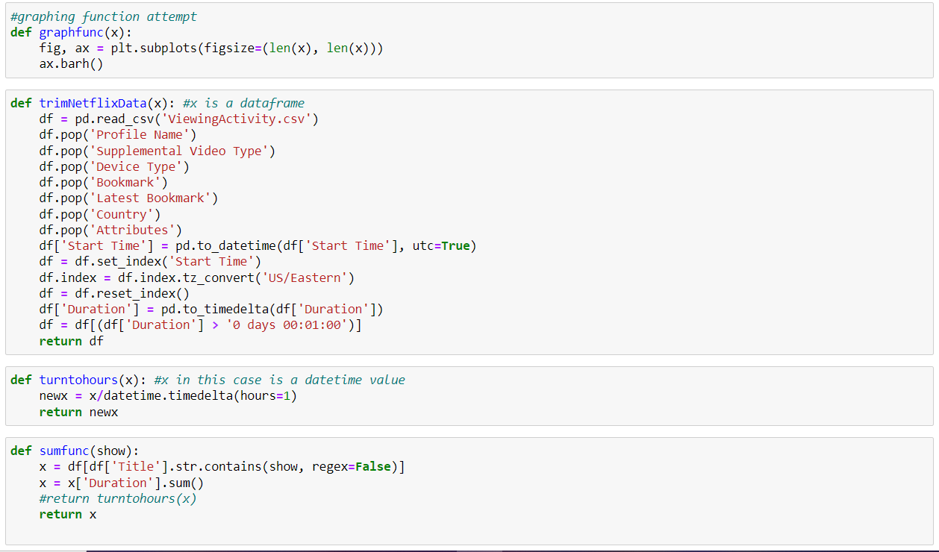
Netflix Bar Chart progress
Next step was getting each show he has watched and adding their times together to get a total value of time for the specified show. After doing this, we started making our functions to start getting our code situated. We have a function to get rid of unwanted columns in the csv file, a graphing function, a function turning the amount of time into hours, and finally a function that takes the show time and turns it into total time.

Slide 8
Netflix Bar Chart progress
We ran into an issue where we could not get the total amount of hours watched into a dictionary of each show. Jake found a Netflix csv file of every show and movie on Netflix. Using this file, we tried taking the Netflix show file and Jake’s Netflix file to add the total time into a dictionary. We could get them into a dictionary but there was another issue where the dictionary had shows in it that Jake had not watched. There was also the issue of time values not changing into hours. This was as far as we got with the project.

Slide 9
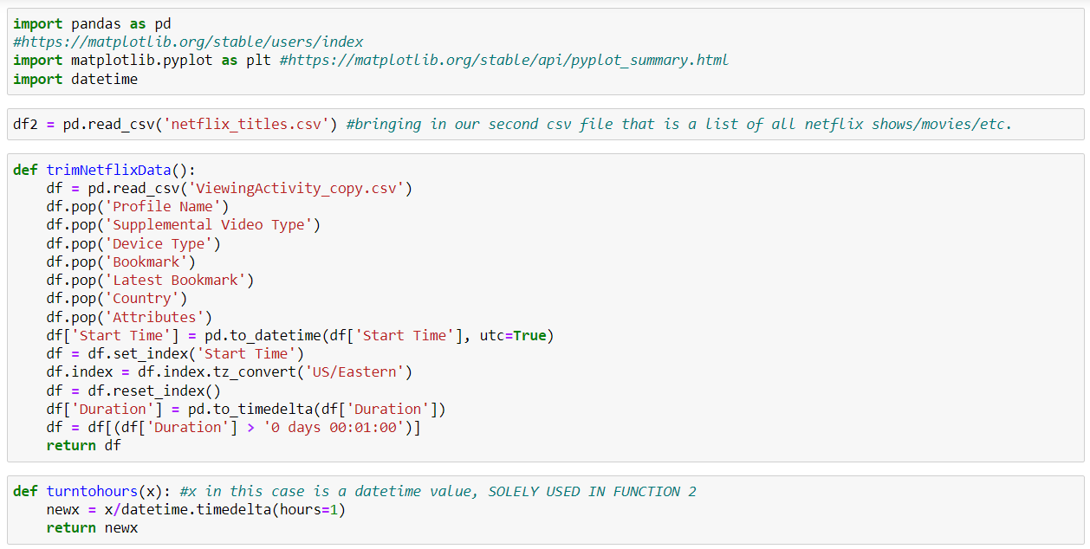
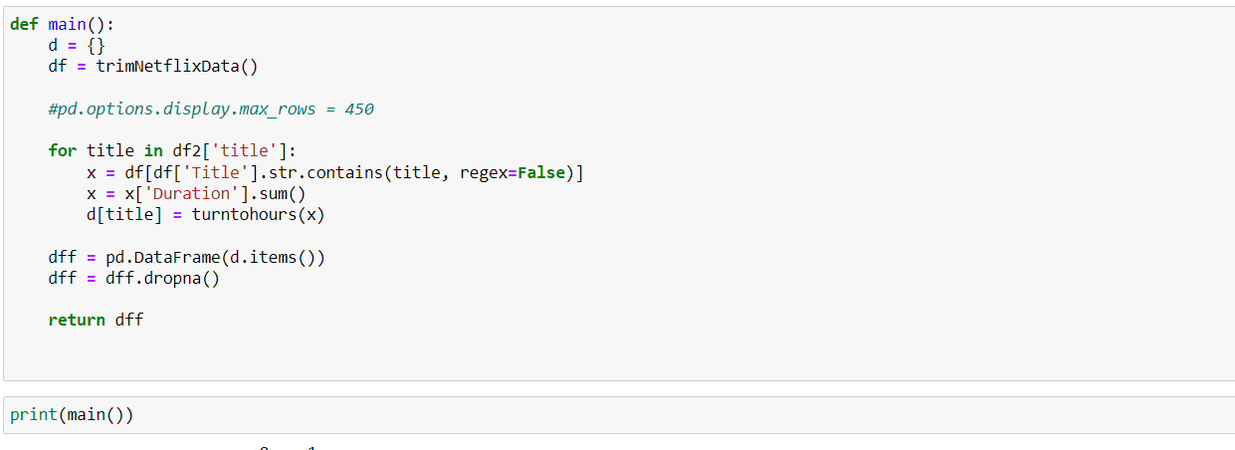
Final Product
This is what we had for our final product without the clutter of our other data.

